Slide 1
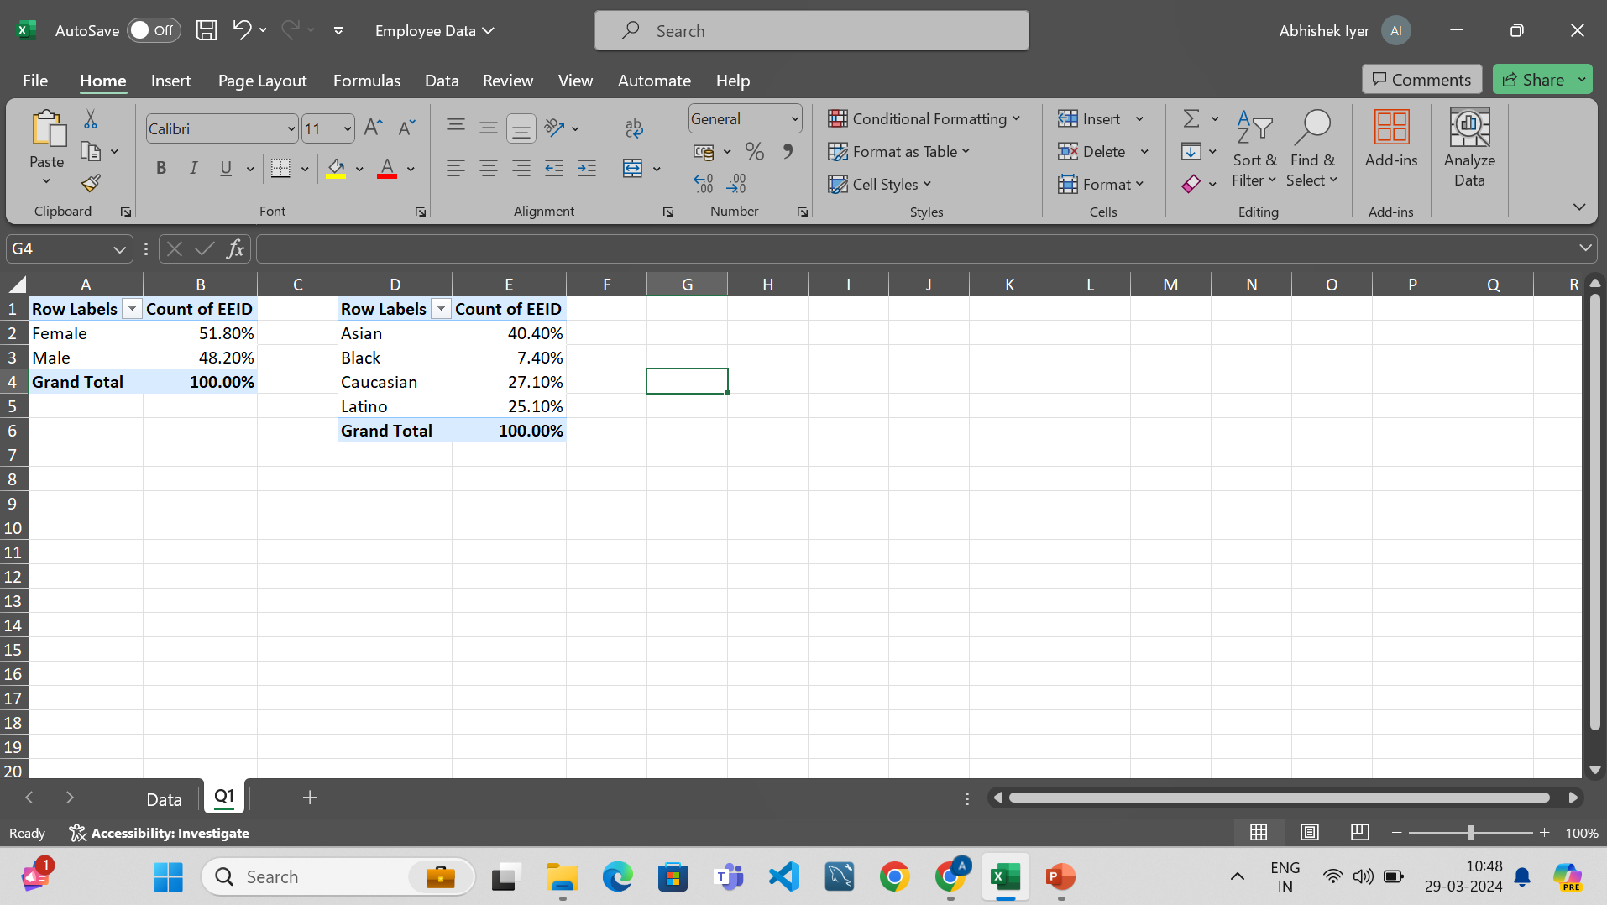

Slide 2
Question 1
Summary of ethnicity and gender distribution
Pivot table -> Select table -> Count of EEID as values -> Gender and ethnicity as row labels.
Conclusion
More female employees than male
More Asian employees than other ethnicities

Slide 3
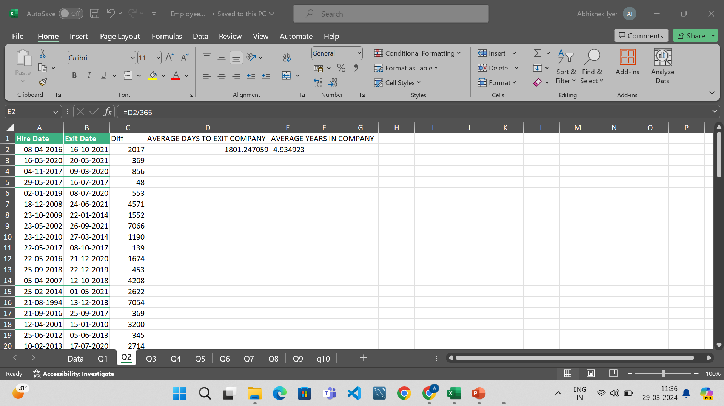

Slide 4
Question 2
Average number of years to exit the company
Copied both hire data and exit date after filtering the dataset
Compute the differences
Take the average
Average days in company = 1801days
Average years in company = 4.9 years

Slide 5
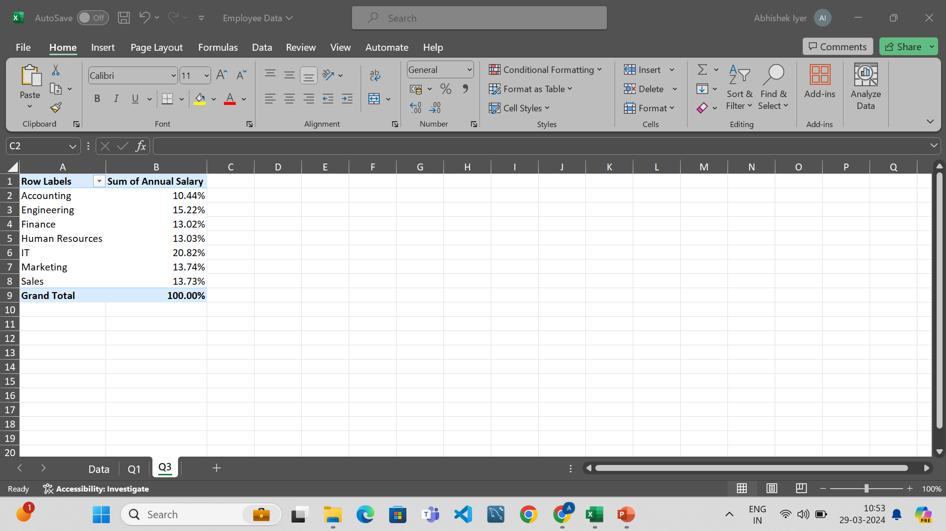

Slide 6
Question 3
To check if there are any differences in salaries between departments
Pivot table -> Insert table -> sum of salaries as values -> departments as rows.
As we can see there aren’t any significant differences in salaries given to different departments. All of the departments salaries range from 12-20% of the total compensation.

Slide 7
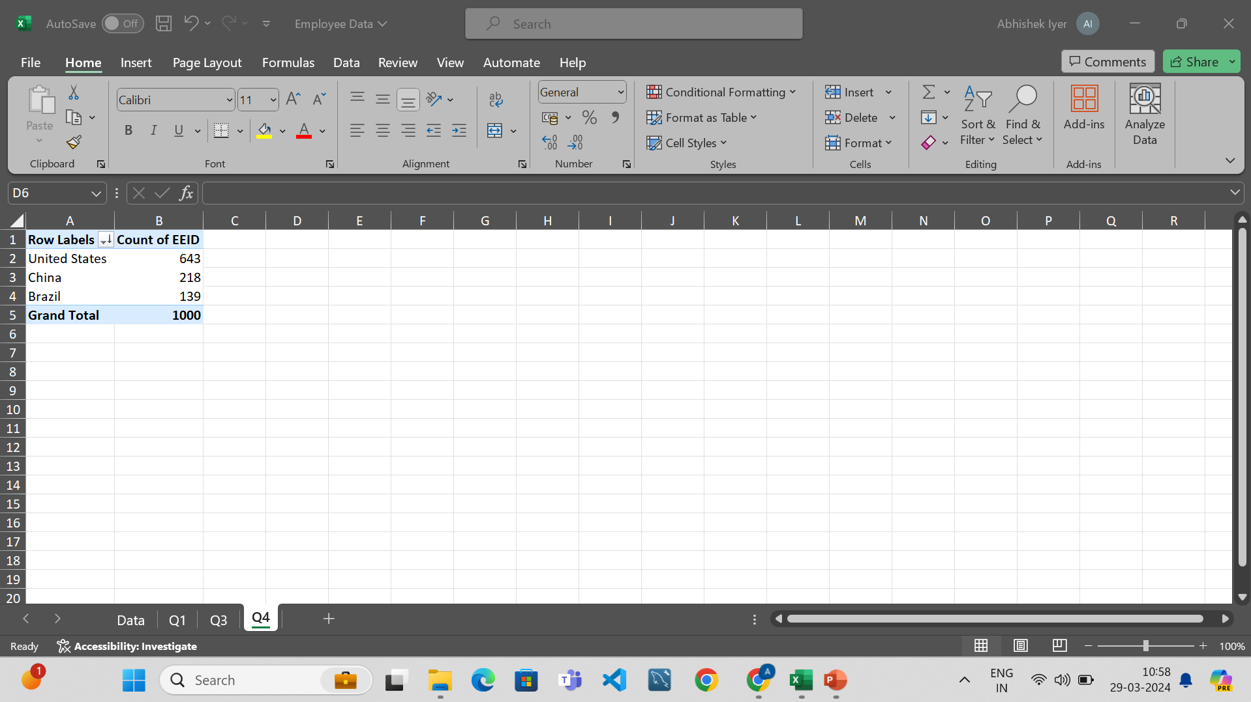

Slide 8
Question 4
To check which country contributes most to the company
Pivot table -> Country in rows -> employee id in values -> sort
We can see that the US contributes the most to the company.

Slide 9
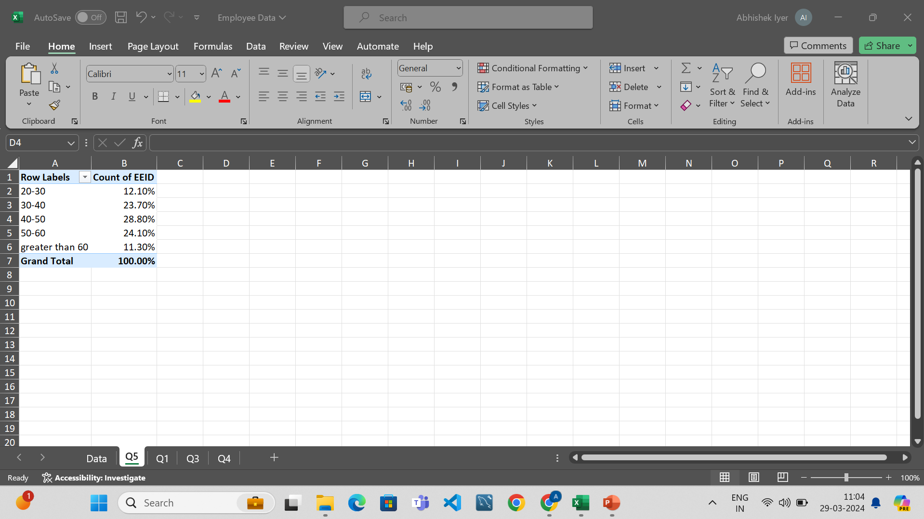

Slide 10
Question 5
To calculate the most common age range amongst employees
Calculate the age range using the IFS statement.
Using pivot table get the count of employees as well as the age rage
Convert into percentage
Conclusion: we can see that the 40-50 age range gives us the most amount of employees.

Slide 11
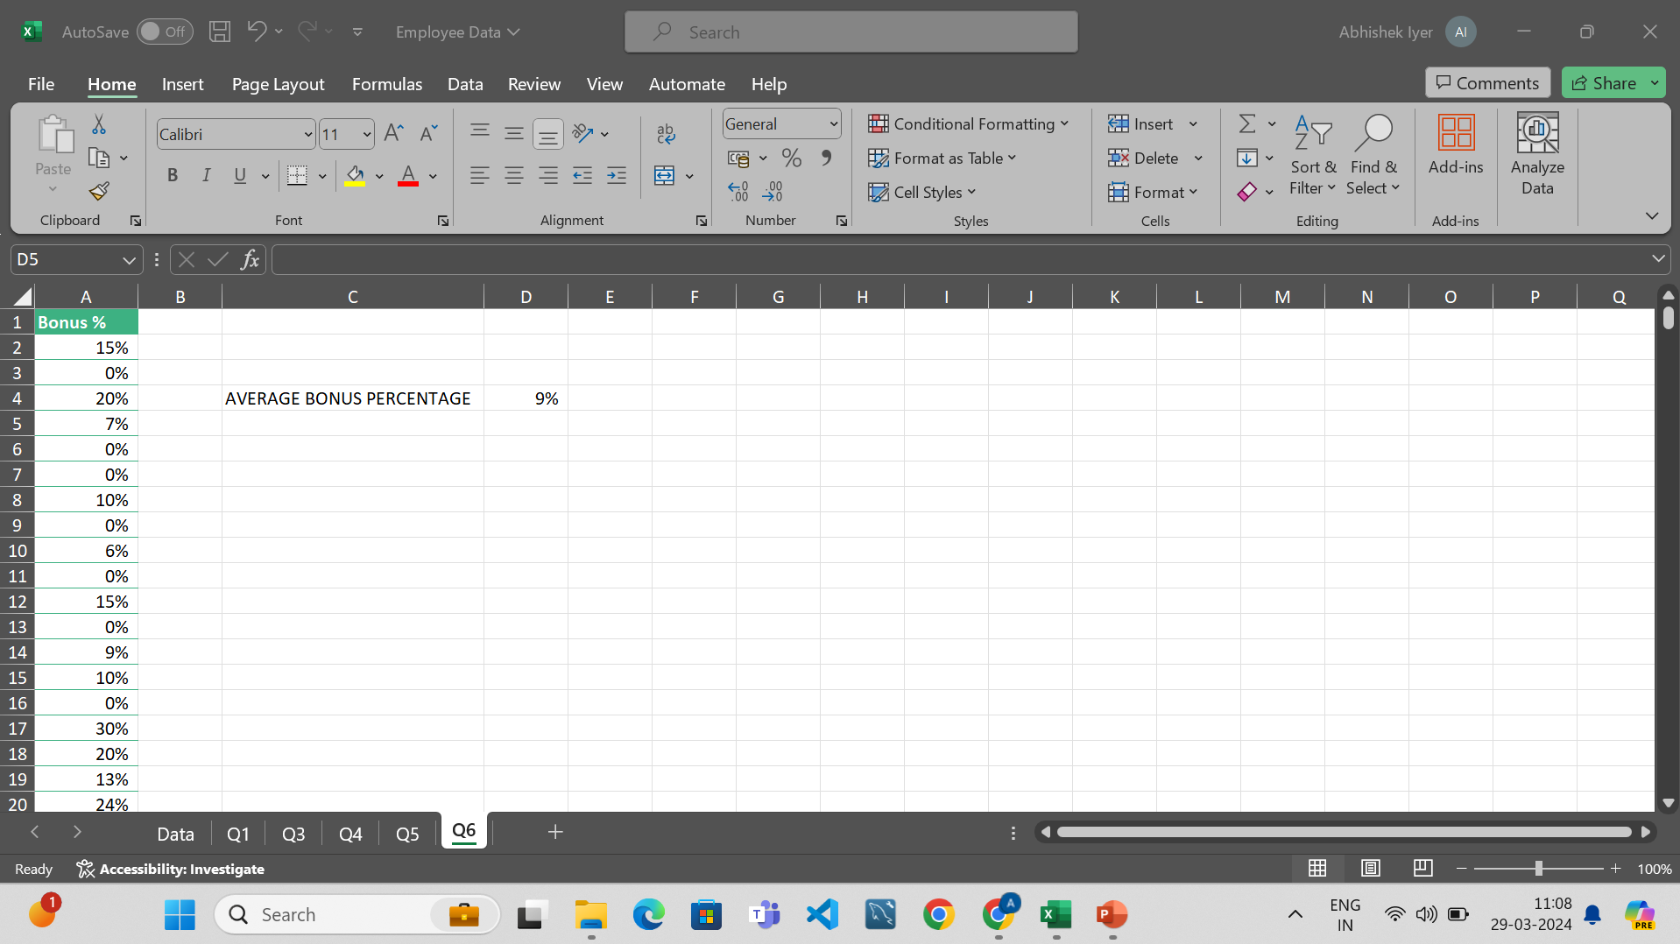

Slide 12
Question 6
What is the average bonus percentage give to employees
Copy the bonus percentage and use the average formula
An average employee in this company is given a 9% bonus.

Slide 13
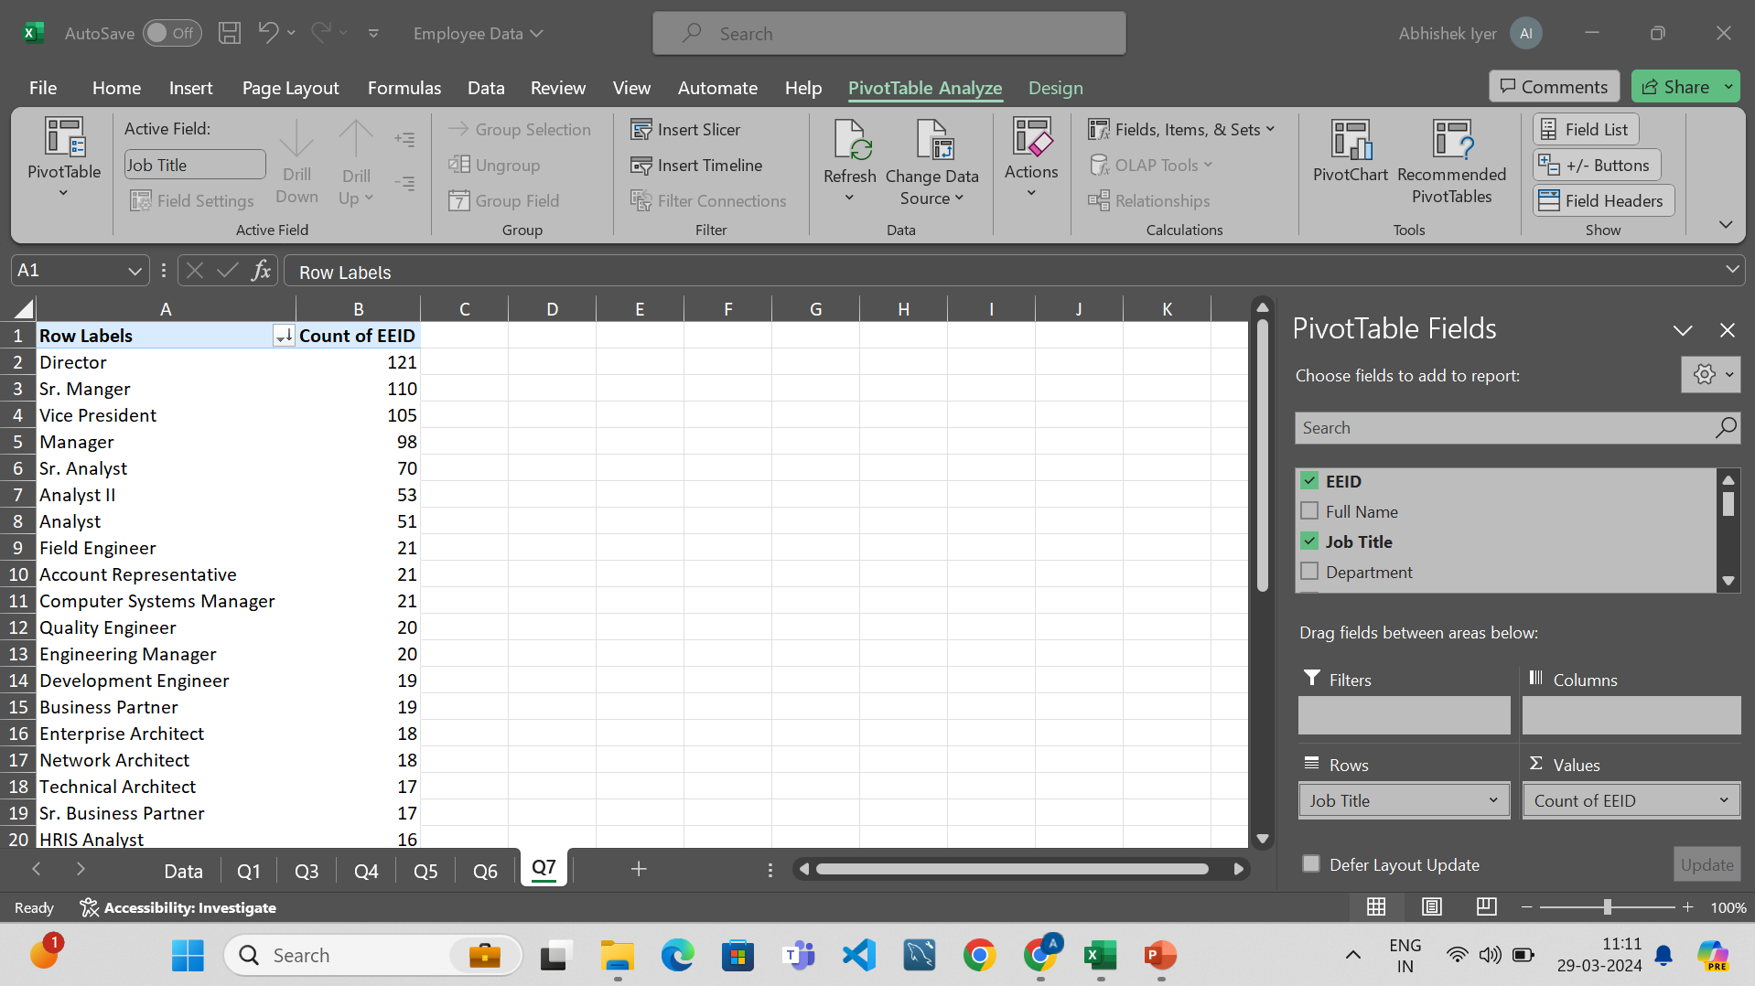

Slide 14
Question 7
What is the most common job title that is occurring in the dataset
We use pivot table and count the number of employees in every job title.
We can see that there are 121 directors in this company. This is the most common job title.

Slide 15
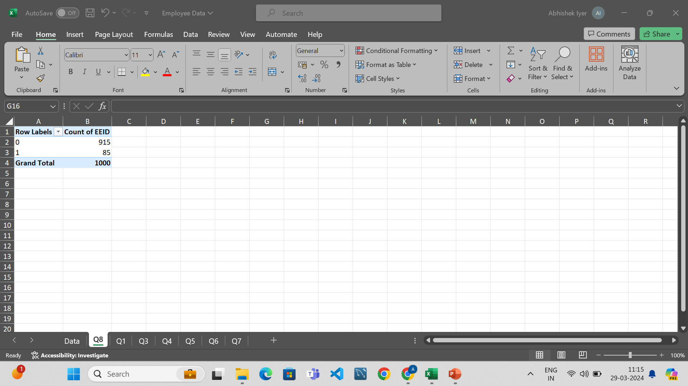

Slide 16
Question 8
There isn’t enough data to site the primary reasons of employees exit.
We have calculated the number of employees who are no longer with the organization.
85 employees have left the organization and the current strength of the company is 915.

Slide 17
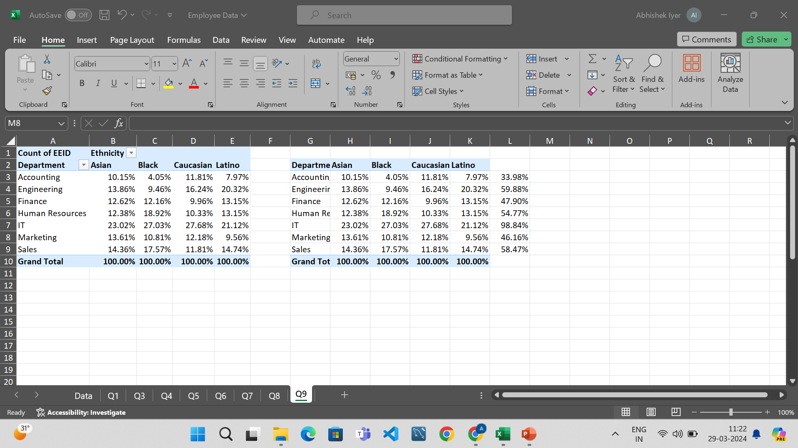

Slide 18
Question 9
We need to check if any department is more ethnic than the rest.
We use pivot table. Using those values.
Using this pivot table, we can see that all these departments are ethnically diverse. The IT department is equally ethnic. i.e there are people from all over the world in equal ratios working in IT.

Slide 19
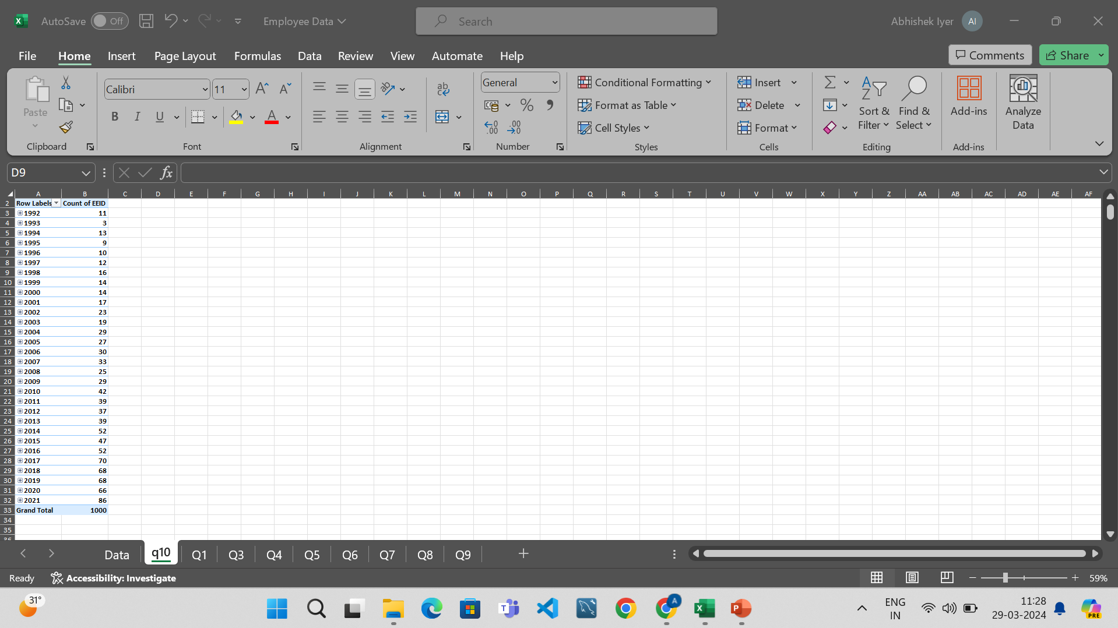

Slide 20
Question 10
To check if there has been an increase in the number of hires over the past few years.
Pivot table -> Count of emp id as values -> hire year as columns.
We can see that from 2016 to 2021, the number of people hired are 52,70,68,68,66,80.
We can say that from 2016 to 2017 there was an increase in hiring and stagnated for 4 years and the hiring rate shot up to 80.

